Slide 1
Bootstrap In Actions
Mai Anh Phuong – June 2018

Slide 2
Agenda
Course Overview
Course Objectives
Main contents
Q & A
Assignment

Slide 3
Course Overview
Sharing some useful components of Bootstrap framework
Sharing keywords and techniques to apply and learn Bootstrap framework
Small assignment to verify our understanding

Slide 4
Course Objectives
Trainees understand main concepts of Bootstrap framework, and be able to build a Web Application using Bootstrap framework.
Trainees can utilize Bootstrap framework strength
Trainees know how to host Spring Boot application
Trainees can work with Bootstrap framework in real-world project without any additional training

Slide 5
Main contents
What’s CSS?
Why’s CSS?
How to use it?
What’s Bootstrap framework?
Why’s Bootstrap?
How does it look like?

Slide 6
What’s CSS?
Notes:
https://www.youtube.com/watch?v=6d_4sd_l7rQ

Slide 7
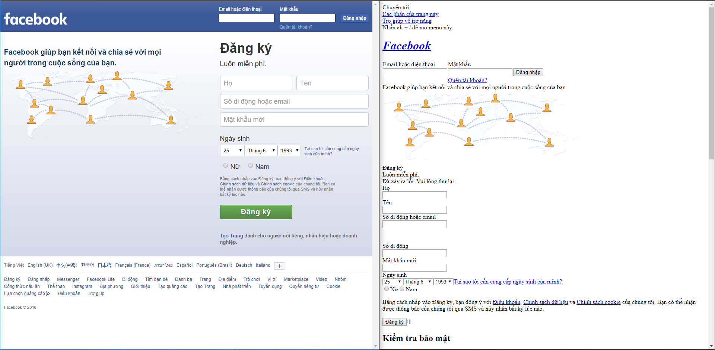

Slide 8
CSS stands for Cascading Style Sheets
CSS describes how HTML elements are to be displayed on screen, paper, or in other media
CSS saves a lot of work. It can control the layout of multiple web pages all at once
External style-sheets are stored in CSS files

Slide 9
HTML vs CSS

Slide 10
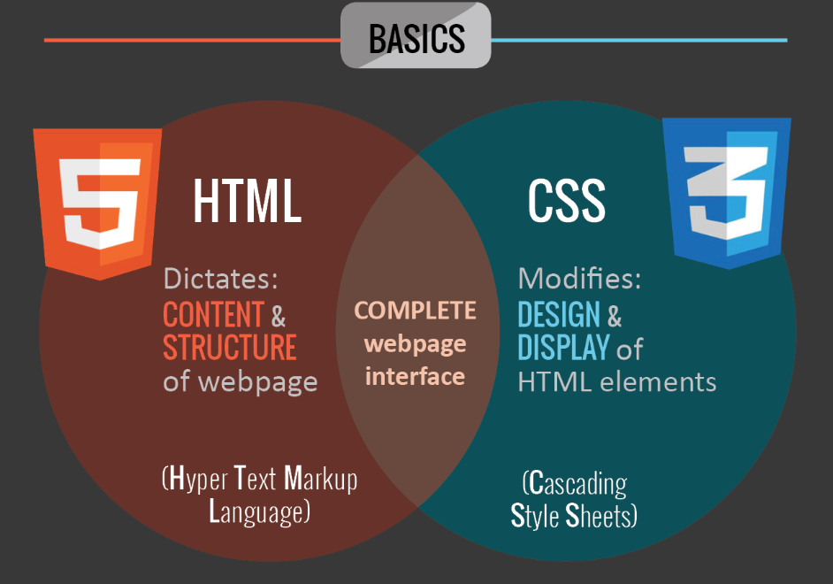

Slide 11
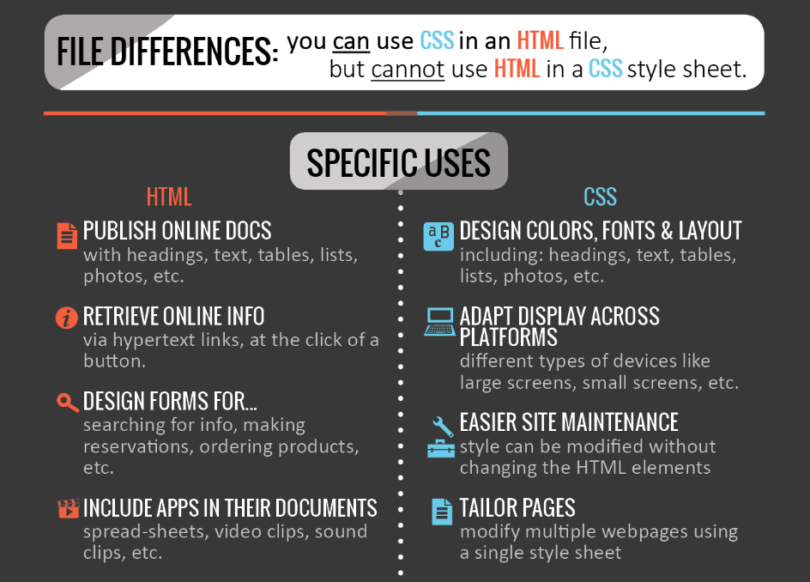

Slide 12
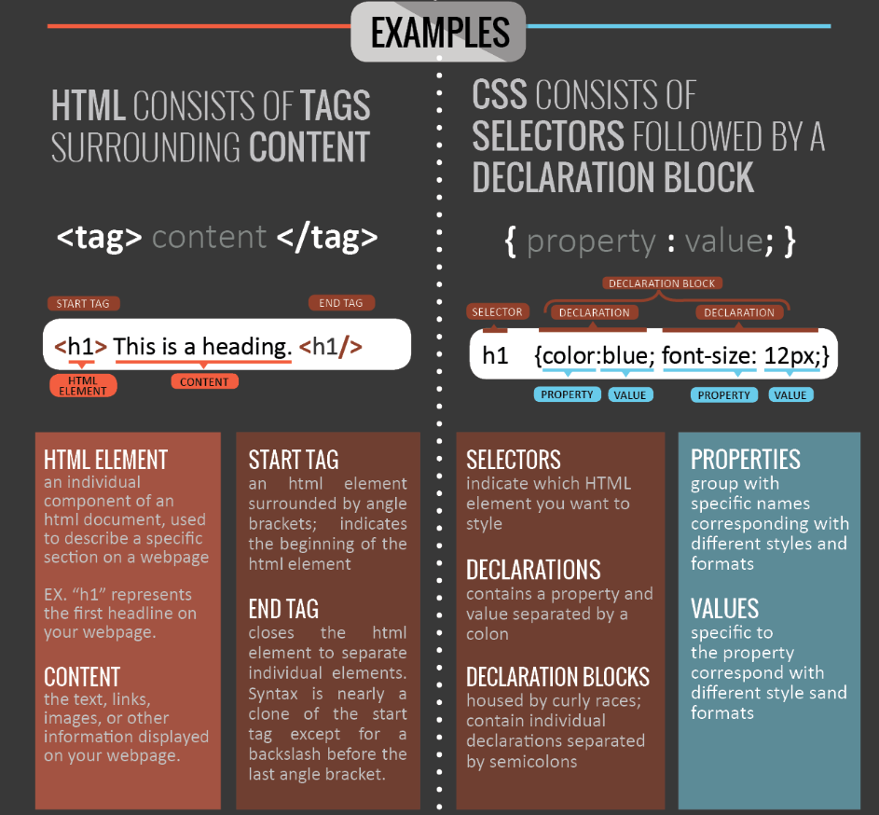

Slide 13
How to...

Slide 14
Three ways to insert CSS
External style sheet
mystyle.css
<head> <link rel="stylesheet" type="text/css" href="mystyle.css"> </head>
<body>
<h1> This is heading </h1>
</body>
body {
background-color: linen;
}
h1 {
color: blue;
margin-left: 20px;
}

Slide 15
Three ways to insert CSS
Internal style sheet
<head> <style>
body {
background-color: linen;
}
h1 {
color: blue;
margin-left: 20px;
}
</style> </head>
<body>
<h1> This is heading </h1>
</body>

Slide 16
Three ways to insert CSS
Inline style
<head>
</head>
<body style="background-color:linen;">
<h1 style="color:blue; margin-left:30px"> This is heading </h1> </body>

Slide 17
What’s Bootstrap framework?

Slide 18
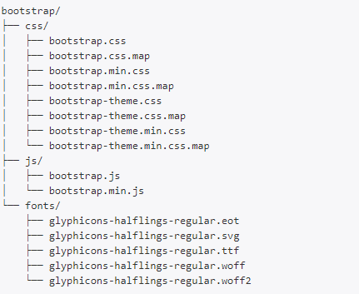
Open-source front-end framework
The most popular HTML, CSS, and JS framework for developing responsive, mobile first projects on the web.
Three main files
bootstrap.css – a CSS framework
bootstrap.js – a Javascript/jQuery
glyphicons – a font (an icon font set)

Slide 19
Why’s Bootstrap?

Slide 20
Easy to use Anybody with just basic knowledge of HTML and CSS can start using Bootstrap
Responsive features Bootstrap's responsive CSS adjusts to phones, tablets, and desktops
Mobile-first approach In Bootstrap 3, mobile-first styles are part of the core framework
Browser compatibility Bootstrap is compatible with all modern browsers (Chrome, Firefox, Internet Explorer, Edge, Safari, and Opera)
Notes:
https://getbootstrap.com/docs/4.1/components/dropdowns/
https://bootsnipp.com

Slide 21
How to...?

Slide 22
Require
Many of our components from bootstrap framework require the use of JQuery to function.
How to start
Import from Internet
<head>
<!-- Bootstrap -->
<link href="https://getbootstrap.com/docs/3.3/dist/css/bootstrap.min.css" rel="stylesheet">
<!-- jQuery (necessary for Bootstrap's JavaScript plugins) -->
<script src="https://ajax.googleapis.com/ajax/libs/jquery/1.12.4/jquery.min.js"></script>
<!-- Include all compiled plugins (below), or include individual files as needed -->
<script src="https://getbootstrap.com/docs/3.3/dist/js/bootstrap.min.js"></script>
</head>

Slide 23
How to start
Import from local
Download Bootstrap and Jquery
https://github.com/twbs/bootstrap/releases/download/v3.3.7/bootstrap-3.3.7-dist.zip
https://code.jquery.com/jquery-1.12.4.min.js
Import for using
<head>
<!-- Bootstrap -->
<link href="ib/css/bootstrap.min.css" rel="stylesheet">
<!-- jQuery (necessary for Bootstrap's JavaScript plugins) -->
<script src=" lib/js/jquery-1.12.4.min.js"></script>
<!-- Include all compiled plugins (below), or include individual files as needed -->
<script src=" lib/js/bootstrap.min.js "></script>
</head>

Slide 24
Bootstrap Components
Buttons
Tables
Thumbnails
Labels
Badges
Dropdown menus
Navs
Navbars
Alerts
Process bars
List groups
Panels
Wells
Carousel
...
Notes:
https://getbootstrap.com/docs/4.1/components/alerts/

Slide 25
Q & A

Slide 26
Assignment

